Slide 1
Unit – IV: Building desktop application
Unit – IV

Slide 2
Contents
Building Windows Forms Applications
Setting Form Properties
Understanding the Life-cycle of a Form
Using the Windows Forms Designer
MessageBox Class
.config File
Working with Windows Forms Controls: TextBox, Button, Selection, List, Container, Image, ErrorProvider, TooltipProvider, etc.
Handling Events: Understanding the Event-Driven Programming Model, Writing Event Handlers, Sharing Event Handlers

Slide 3
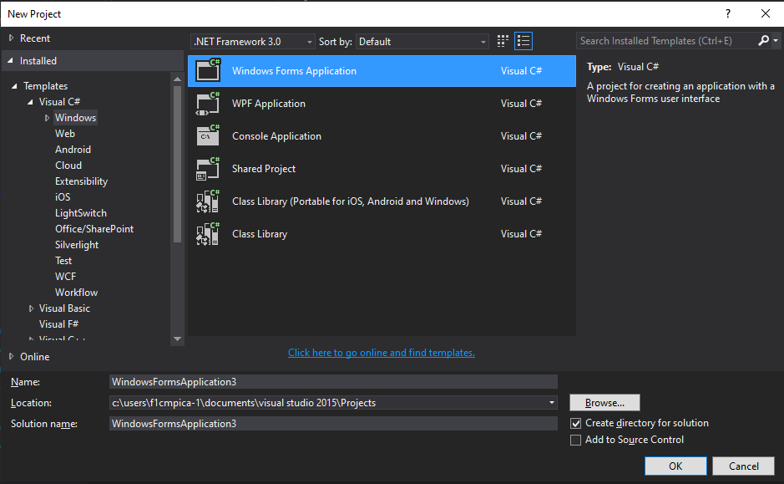
Building Windows Forms Applications
Visual Studio →New Project →Templates →Visual C# → Windows →Windows Forms Applications

Slide 4
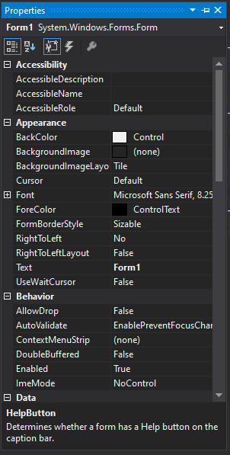
Setting Form Properties
Right click on form →select properties.
Some major properties:
BackColor, BackgroundImage, Font, ForeColor, Text
Name, Size, ControlBox, IsMdiContainer
MainMenuStrip

Slide 5
Understanding the Life-cycle of a Form
Knowing the lifecycle of a Form can help you place important bits of code in relevant events.

Slide 6
Understanding the Life-cycle of a Form
Move: This event occurs when the form is moved. Although by default, when a form is instantiated and launched, the user does not move it, yet this event is triggered before the Load event occurs.
Load: This event occurs before a form is displayed for the first time.
VisibleChanged: This event occurs when the Visible property value changes.
Activated: This event occurs when the form is activated in code or by the user.
Shown: This event occurs whenever the form is first displayed.
Paint: This event occurs when the control is redrawn.
Deactivate: This event occurs when the form loses focus and is not the active form.
Closing: This event occurs when the form is closing. Memory allocated to controls of the form is freed.
Closed: This event occurs after the form is closed. After this even memory allocated to the form is freed.

Slide 7
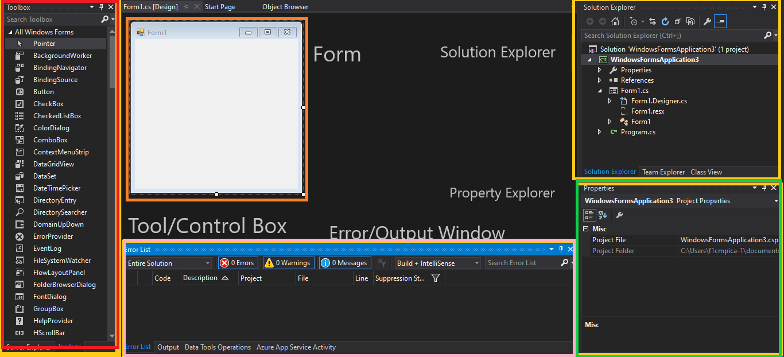
Using the Windows Forms Designer

Slide 8
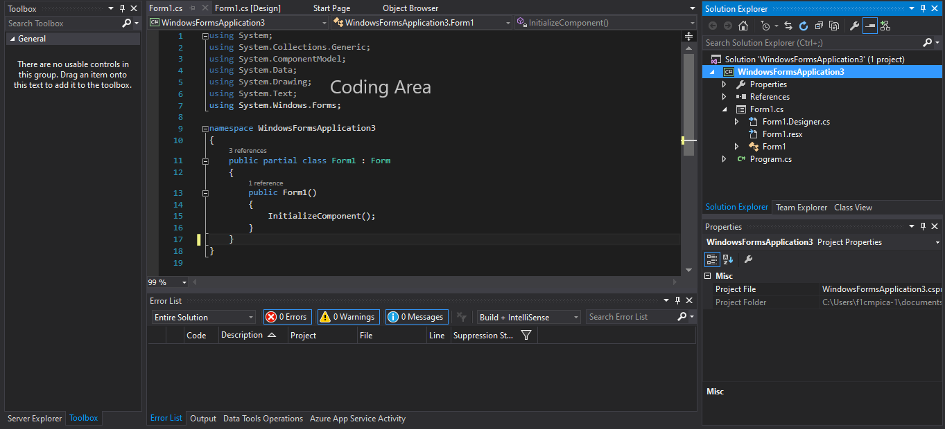
Windows Forms Designer

Slide 9

MessageBox Class
Displays a message window, also known as a dialog box, which presents a message to the user.
It is a modal window, blocking other actions in the application until the user closes it.
A MessageBox can contain text, buttons, and symbols that inform and instruct the user.

Slide 10
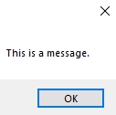
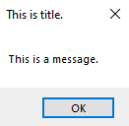
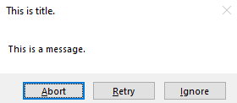
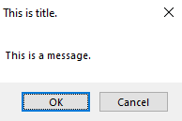
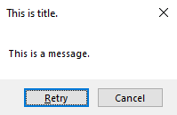
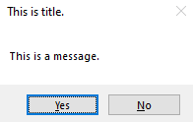
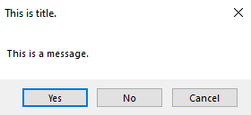
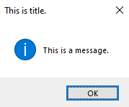
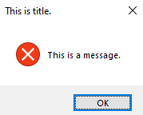
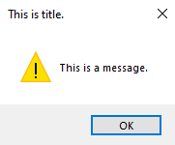
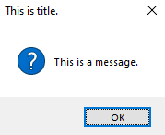
Examples of messagebox

Slide 11
Messagebox class
MessageBoxButtons class is used to show different combination of buttons on message box.
MessageBoxButtons.AbortRetryIgnore
MessageBoxButtons.OK
MessageBoxButtons.OKCancel
MessageBoxButtons.RetryCancel
MessageBoxButtons.YesNo
MessageBoxButtons.YesNoCancel

Slide 12
Messagebox class
MessageBoxIcon class is used to show different icons along with buttons.
MessageBoxIcon.Information
MessageBoxIcon.None
MessageBoxIcon.Question
MessageBoxIcon.Stop
MessageBoxIcon.Warning

Slide 13
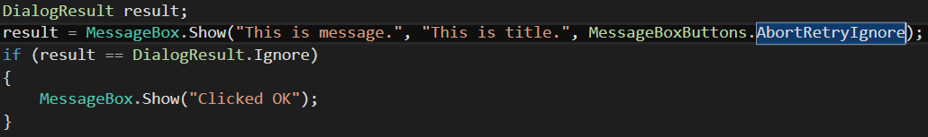
Messagebox class
Getting values from users based on buttons clicked by the user.
Messagebox returns value of type “DialogueResult”.

Slide 14
.config File
At its simplest, the app.config is an XML file with many predefined configuration sections available and support for custom configuration sections.
A "configuration section" is a snippet of XML with a schema meant to store some type of information.
Settings can be configured using built-in configuration sections such as connectionStrings or appSettings. You can add your own custom configuration sections; this is an advanced topic, but very powerful for building strongly-typed configuration files.
Web applications typically have a web.config, while Windows GUI/service applications have an app.config file.
Application-level config files inherit settings from global configuration files, e.g. the machine.config.

Slide 15
.config File
An application configuration file contains settings that are specific to an app.
This file includes configuration settings that the common language runtime reads (such as assembly binding policy, remoting objects, and so on), and settings that the app can read.

Slide 16
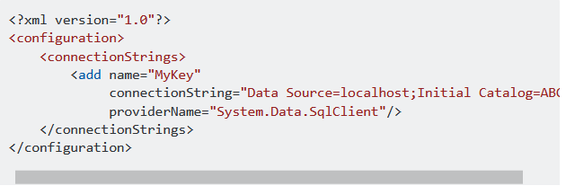
Example of .config File

Slide 17
.config File
Once you have defined your app.config, you can read it in code using the ConfigurationManager class.

Slide 18
Configuration file schema
<configuration> Element: The top-level element for all configuration files.
<assemblyBinding> Element: Specifies assembly binding policy at the configuration level.
<linkedConfiguration> Element: Specifies a configuration file to include.
Startup Settings Schema: Elements that specify which version of the common language runtime to use.
Runtime Settings Schema: Elements that configure assembly binding and runtime behavior.
Network Settings Schema: Elements that specify how the .NET Framework connects to the internet.
Cryptography Settings Schema: Elements that map friendly algorithm names to classes that implement cryptography algorithms.
Configuration Sections Schema: Elements used to create and use configuration sections for custom settings.

Slide 19
Configuration file schema
Trace and Debug Settings Schema: Elements that specify trace switches and listeners.
Compiler and Language Provider Settings Schema: Elements that specify compiler configuration for available language providers.
Application Settings Schema: Elements that enable a Windows Forms or ASP.NET application to store and retrieve application-scoped and user-scoped settings.
App Settings Schema: Contains custom application settings, such as file paths, XML Web service URLs, or any other custom configuration information for an application.
Web Settings Schema: Elements for configuring how ASP.NET works with a host application such as IIS. Used in Aspnet.config files.
Windows Forms Configuration Schema: All elements in the Windows Forms application configuration section, which includes customizations such as multi-monitor and high-DPI support.
WCF Configuration Schema: All elements that enable you to configure WCF service and client applications.
WIF Configuration Schema: All elements of the Windows Identity Foundation (WIF) configuration schema.

Slide 20
Working with Windows Forms Controls
TextBox
Button
Selection
List
Container
Image
ErrorProvider
TooltipProvider

Slide 21
Textbox
In the textBox control, the user can enter text in an application.
This control has additional functionality that is not found in the standard Windows text box control, including multiline editing and password character masking.
Typically, a TextBox control is used to display, or accept as input, a single line of text.
You can use the Multiline and ScrollBars properties to enable multiple lines of text to be displayed or entered.
Set the AcceptsTab and AcceptsReturn properties to true to enable greater text manipulation in a multiline TextBox control.

Slide 22
Textbox
You can limit the amount of text entered into a TextBox control by setting the MaxLength property to a specific number of characters.
TextBox controls can also be used to accept passwords and other sensitive information.
You can use the PasswordChar property to mask characters entered in a single-line version of the control.
Use the CharacterCasing property to enable the user to type only uppercase, only lowercase, or a combination of uppercase and lowercase characters into the TextBox control.

Slide 23
Textbox
To scroll the contents of the TextBox until the cursor (caret) is within the visible region of the control, you can use the ScrollToCaret method.
To select a range of text in the text box, you can use the Select method.
To restrict text from being entered in a TextBox control, you can create an event handler for the KeyDown event in order to validate each character entered in the control.
You can also restrict all entry of data in a TextBox control by setting the ReadOnly property to true.
More Information: https://docs.microsoft.com/en-us/dotnet/api/system.windows.forms.textbox

Slide 24
Button
A Button can be clicked by using the mouse, ENTER key, or SPACEBAR if the button has focus.
Set the AcceptButton or CancelButton property of a Form to allow users to click a button by pressing the ENTER or ESC keys even if the button does not have focus. This gives the form the behavior of a dialog box.
When you display a form using the ShowDialog method, you can use the DialogResult property of a button to specify the return value of ShowDialog.

Slide 25
Button
You can change the button's appearance.
For example, to make it appear flat for a Web look, set the FlatStyle property to FlatStyle.Flat.
The FlatStyle property can also be set to FlatStyle.Popup, which appears flat until the mouse pointer passes over the button; then the button takes on the standard Windows button appearance.
More Information: https://docs.microsoft.com/en-us/dotnet/api/system.windows.forms.button?view=netcore-3.1

Slide 26
Selection – Check Box
Use a CheckBox to give the user an option, such as true/false or yes/no.
The CheckBox control can display an image or text or both.
CheckBox and RadioButton controls have a similar function: they allow the user to choose from a list of options.
CheckBox controls let the user pick a combination of options.
In contrast, RadioButton controls allow a user to choose from mutually exclusive options.
The Appearance property determines whether the CheckBox appears as a typical CheckBox or as a button.

Slide 27
Selection – Check Box
The ThreeState property determines whether the control supports two or three states.
Use the Checked property to get or set the value of a two-state CheckBox control and use the CheckState property to get or set the value of a three-state CheckBox control.
The FlatStyle property determines the style and appearance of the control. If the FlatStyle property is set to FlatStyle.System, the user's operating system determines the appearance of the control.
More information: https://docs.microsoft.com/en-us/dotnet/api/system.windows.forms.checkbox?view=netcore-3.1

Slide 28
Selection – Radio Button
The RadioButton control can display text, an Image, or both.
When the user selects one option button (also known as a radio button) within a group, the others clear automatically.
All RadioButton controls in a given container, such as a Form, constitute a group.
To create multiple groups on one form, place each group in its own container, such as a GroupBox or Panel control.
RadioButton and CheckBox controls have a similar function: they offer choices a user can select or clear.
The difference is that multiple CheckBox controls can be selected at the same time, but option buttons are mutually exclusive.

Slide 29
Selection – Radio Button
Use the Checked property to get or set the state of a RadioButton.
The option button's appearance can be altered to appear as a toggle-style button or as a standard option button by setting the Appearance property.
More information: https://docs.microsoft.com/en-us/dotnet/api/system.windows.forms.radiobutton?view=netcore-3.1

Slide 30
List – ListBox
The ListBox control enables you to display a list of items to the user that the user can select by clicking.
A ListBox control can provide single or multiple selections using the SelectionMode property.
The ListBox also provides the MultiColumn property to enable the display of items in columns instead of a straight vertical list of items.
With this, the control can display more visible items and the user no longer needs to scroll to an item.

Slide 31
List – ListBox
Typically, Windows handles the task of drawing the items to display in the ListBox.
You can use the DrawMode property, and handle the MeasureItem and DrawItem events so you can override the automatic drawing that Windows provides and draw the items yourself.
You can use owner-drawn ListBox controls to display variable-height items, images, or a different color or font for the text of each item in the list.
The HorizontalExtent property, GetItemHeight, and GetItemRectangle also help you draw your own items.

Slide 32
List – ListBox
In addition to display and selection functionality, the ListBox also provides features that enable you to efficiently add items to the ListBox and to find text within the items of the list.
The BeginUpdate and EndUpdate methods enable you to add a large number of items to the ListBox without the control being repainted each time an item is added to the list.
The FindString and FindStringExact methods enable you to search for an item in the list that contains a specific search string.
The Items, SelectedItems, and SelectedIndices properties provide access to the collections that are used by the ListBox.

Slide 33
List – ListBox
The Add method of the ListBox.ObjectCollection class enables you to add items to the ListBox.
The Add method can accept any object when adding a member to the ListBox.
When an object is being added to the ListBox, the control uses the text defined in the ToString method of the object unless a member name within the object is specified in the DisplayMember property.
In addition to adding items using the Add method of the ListBox.ObjectCollection class you can also add items using the DataSource property of the ListControl class.
More information: https://docs.microsoft.com/en-us/dotnet/api/system.windows.forms.listbox?view=netcore-3.1

Slide 34
List – ComboBox
A ComboBox displays a text box combined with a ListBox, which enables the user to select items from the list or enter a new value.
The DropDownStyle property specifies whether the list is always displayed or whether the list is displayed in a drop-down.
The DropDownStyle property also specifies whether the text portion can be edited.
There is no setting to always display the list and disallow entering a new value.
To display a list to which no new values can be added, use a ListBox control.

Slide 35
List – ComboBox
To add or remove objects in the list at run time, use methods of the ComboBox.ObjectCollection class (through the Items property of the ComboBox).
You can assign an array of object references with the AddRange method.
The list then displays the default string value for each object. You can add individual objects with the Add method.
You can delete items with the Remove method or clear the entire list with the Clear method.

Slide 36
List – ComboBox
In addition to display and selection functionality, the ComboBox also provides features that enable you to efficiently add items to the ComboBox and to find text within the items of the list.
With the BeginUpdate and EndUpdate methods, you can add a large number of items to the ComboBox without the control being repainted each time an item is added to the list.
The FindString and FindStringExact methods enable you to search for an item in the list that contains a specific search string.

Slide 37
List – ComboBox
You can use these properties to manage the currently selected item in the list, the Text property to specify the string displayed in the editing field, the SelectedIndex property to get or set the current item, and the SelectedItem property to get or set a reference to the object.
More information: https://docs.microsoft.com/en-us/dotnet/api/system.windows.forms.combobox?view=netcore-3.1

Slide 38
Container
A ContainerControl represents a control that can function as a container for other controls and provides focus management.
Controls that inherit from this class can track the active control they contain, even when the focus moves somewhere within a different container.
ContainerControl objects provide a logical boundary for contained controls.
The container control can capture the TAB key press and move focus to the next control in the collection.
More information: https://docs.microsoft.com/en-us/dotnet/api/system.windows.forms.containercontrol?view=netcore-3.1

Slide 39
Image
Represents a control that displays an image.
The Image class enables you to load the following image types: .bmp, .gif, .ico, .jpg, .png, .wdp, and .tiff.
When displaying a multiframe image, only the first frame is displayed. The animation of multiframe images is not supported by the Image control.
Until the image content is loaded, the ActualWidth and ActualHeight of the control will report as zero, because the image content is used to determine the final size and location of the control.
For a fixed size control, the Width and/or Height properties can be set. However, to preserve the media's aspect ratio, set the Width or Height properties but not both.
More information: https://docs.microsoft.com/en-us/dotnet/api/system.windows.controls.image?view=netcore-3.1

Slide 40
ErrorProvider
Provides a user interface for indicating that a control on a form has an error associated with it.
ErrorProvider presents a simple mechanism for indicating to the end user that a control on a form has an error associated with it.
If an error description string is specified for the control, an icon appears next to the control.
The icon flashes in the manner specified by BlinkStyle, at the rate specified by BlinkRate.
When the mouse hovers over the icon, a ToolTip appears showing the error description string.

Slide 41
ErrorProvider
Typically, you use ErrorProvider in association with data-bound controls.
When using ErrorProvider with data-bound controls, you must specify the ContainerControl, either in the constructor or by setting the ContainerControl property.
More information: https://docs.microsoft.com/en-us/dotnet/api/system.windows.forms.errorprovider?view=netcore-3.1

Slide 42
ToolTipProvider
Represents a small rectangular pop-up window that displays a brief description of a control's purpose when the user rests the pointer on the control.
The ToolTip class is typically used to alert users to the intended use of a control.
For example, you can specify ToolTip text for a TextBox control that accepts a name, specifying the format of the name to be typed into the control.
In addition to providing hints, you can also use the ToolTip class to provide run time status information.
For example, you can use the ToolTip class to display connection speed and line quality data when the user moves the pointer onto a PictureBox control that displays Internet connection status.

Slide 43
ToolTipProvider
The ToolTip class can be used in any container.
To explicitly specify a container, use the ToolTip(IContainer) constructor.
A single ToolTip component typically is used to create ToolTips for multiple controls on a single form.
After you create a ToolTip, use a separate call to the SetToolTip method to associate ToolTip display text to an individual control.
Then when the user moves the pointer on a control, the ToolTip with its text is displayed.

Slide 44
ToolTipProvider
You can call SetToolTip more than once for the same control to change the text that is associated with the control.
To get the text that is associated with a control, use the GetToolTip method.
To remove all ToolTip text associations with an instance of the ToolTip class, use the RemoveAll method.
More information: https://docs.microsoft.com/en-us/dotnet/api/system.windows.forms.tooltip?view=netcore-3.1

Slide 45
All about events
Handling Events:
Understanding the Event-Driven Programming Model – Demo
Writing Event Handlers – Demo
Sharing Event Handlers – Demo

